Slide 1
Weather to Cosmic Rays: Machine Learning for Particle Flux
Carter Chapman
Andrei Gogosha

Slide 2
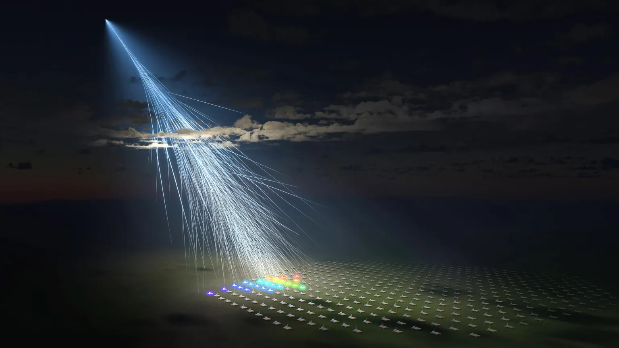
Presentation Outline
Introduction
Overview, Cosmic Rays, Pierre Auger Observatory
Methods
SHAP Feature Importance, Data, Preprocessing, Weather, Model
Results
Model Performance and SHAP Feature Importance
Conclusion
Outlook, Future Improvements
Figure 1: Particle Shower induced by Cosmic Ray [1]

Slide 3
Overview
Use weather data from the Pierre Auger Observatory to predict cosmic ray count rates
Understanding this relationship helps pick experiment site location, understand variations in cosmic ray data, and protect sensitive equipment from cosmic ray exposure
Use SGDRegressor (linear), and a gradient boosted decision tree (non-linear)
Verify our physics based understanding by investigating feature importance with SHAP (SHapley Additive exPlanations)
Goal is to have a Mean Absolute Error < 15 counts per second

Slide 4
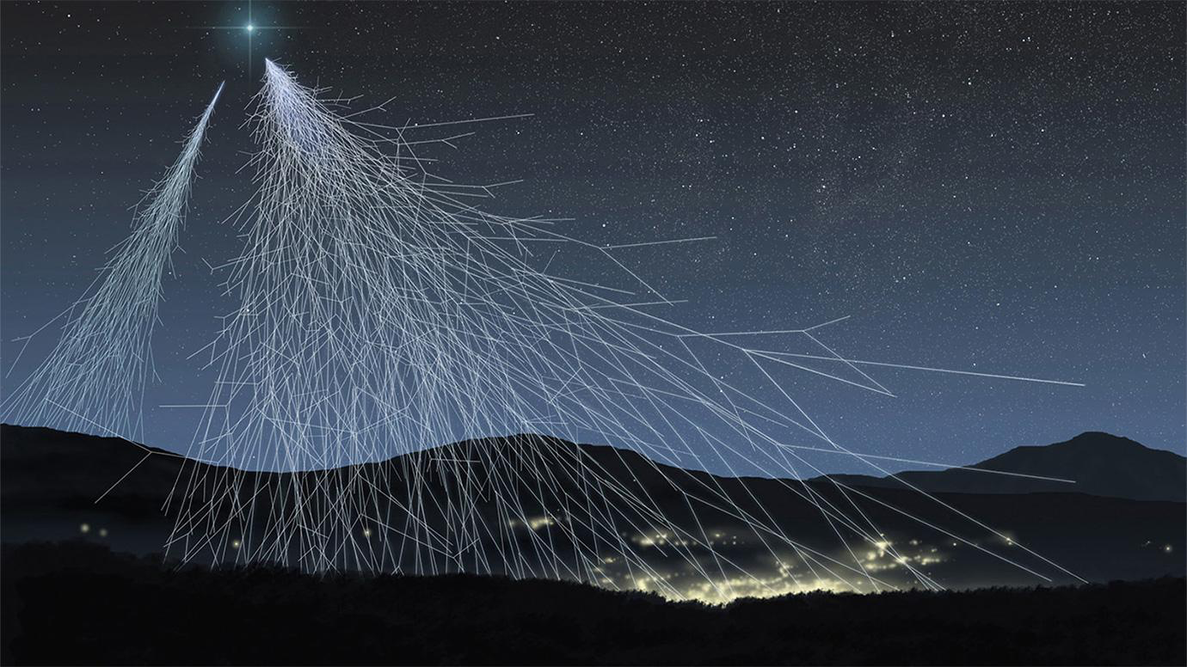
Cosmic Rays
Energetic particles from outer space
Can originate from the Sun, black holes, supernovae, and outside our galaxy
Interactions with the atmosphere create showers of secondary particles (air showers)
Secondary Showers are measured on the surface for insight into cosmic ray energy, however are subject to variations in the weather
Figure 2: Particle Shower induced by Cosmic Ray [2]

Slide 5
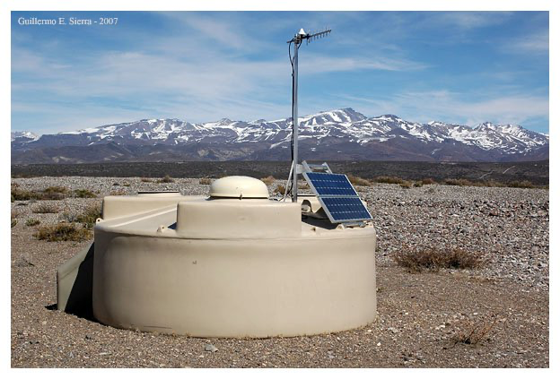
Pierre Auger Observatory
Cosmic Ray observatory located in Argentina
1660 Water tank detectors are spread out over 3000 km^2
Detect particles on the surface of the earth
Also have UV detectors that measure the brightness of UV light emitted from interactions in the atmosphere
Pierre Auger has five different weather stations taking measurements on pressure, density, temperature
Figure 3: Water Detector at Pierre Auger [3]

Slide 6
Weather
Different atmospheric variables affect the characteristics of an air shower
While not a huge factor, variables can induce biases in measurements
Pierre Auger already uses linear correction shown in eq 1, to account for variations in weather
Our goal is to use ML Models to recreate this relationship leveraging the fact that this relationship exists
Equation 1: Correction from Pierre Auger to adjust for weather conditions. S(r_opt) is the detected signal, S_o is the expected signal, alpha and beta are coefficients, P_0 and p_o are the yearly averages for pressure and density, P and p_d are the measured pressure and density, and p_~ is the density two hours ago (to account for changes in density higher up in the atmosphere where the air shower began [4]

Slide 7
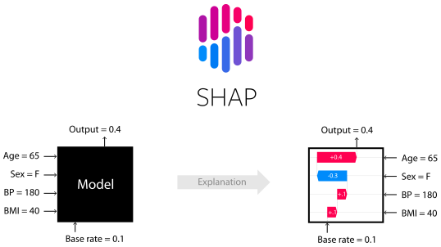
SHAP (SHapley Additive exPlanations)
Method for interpreting machine-learning models by explaining how each feature contributes to a single prediction and to the model overall
Based on Shapley Game Theory, treats each feature as a player in a game and assigns each feature a share of responsibility in making a decision
Model Agnostic
Allows us to directly see which features have the greatest impact on the final predicted cosmic ray flux
Greater model transparency and illustrates direct relationships between the prediction and feature values [5]
Figure 4: Water Detector at Pierre Auger [7]

Slide 8
Data
Data is from the Pierre Auger Open-Release Scalar Data set [7]
Has 10% of all cosmic ray data, and 100% of all weather data collected from March 2005 to December 2020
Weather data used is a culmination of data collected at every station
Scalar mode counts the total number of hits across all 1660 detectors within a 1 second coincidence window and is uncorrected for weather effects and operable detectors
Scalar Data has been used to measure solar activity, and Forbush decreases [8]
Notes:
Scalar Data helps analyze cosmic ray data on a larger level as opposed to individual particles, hence no particle phenomenology

Slide 9
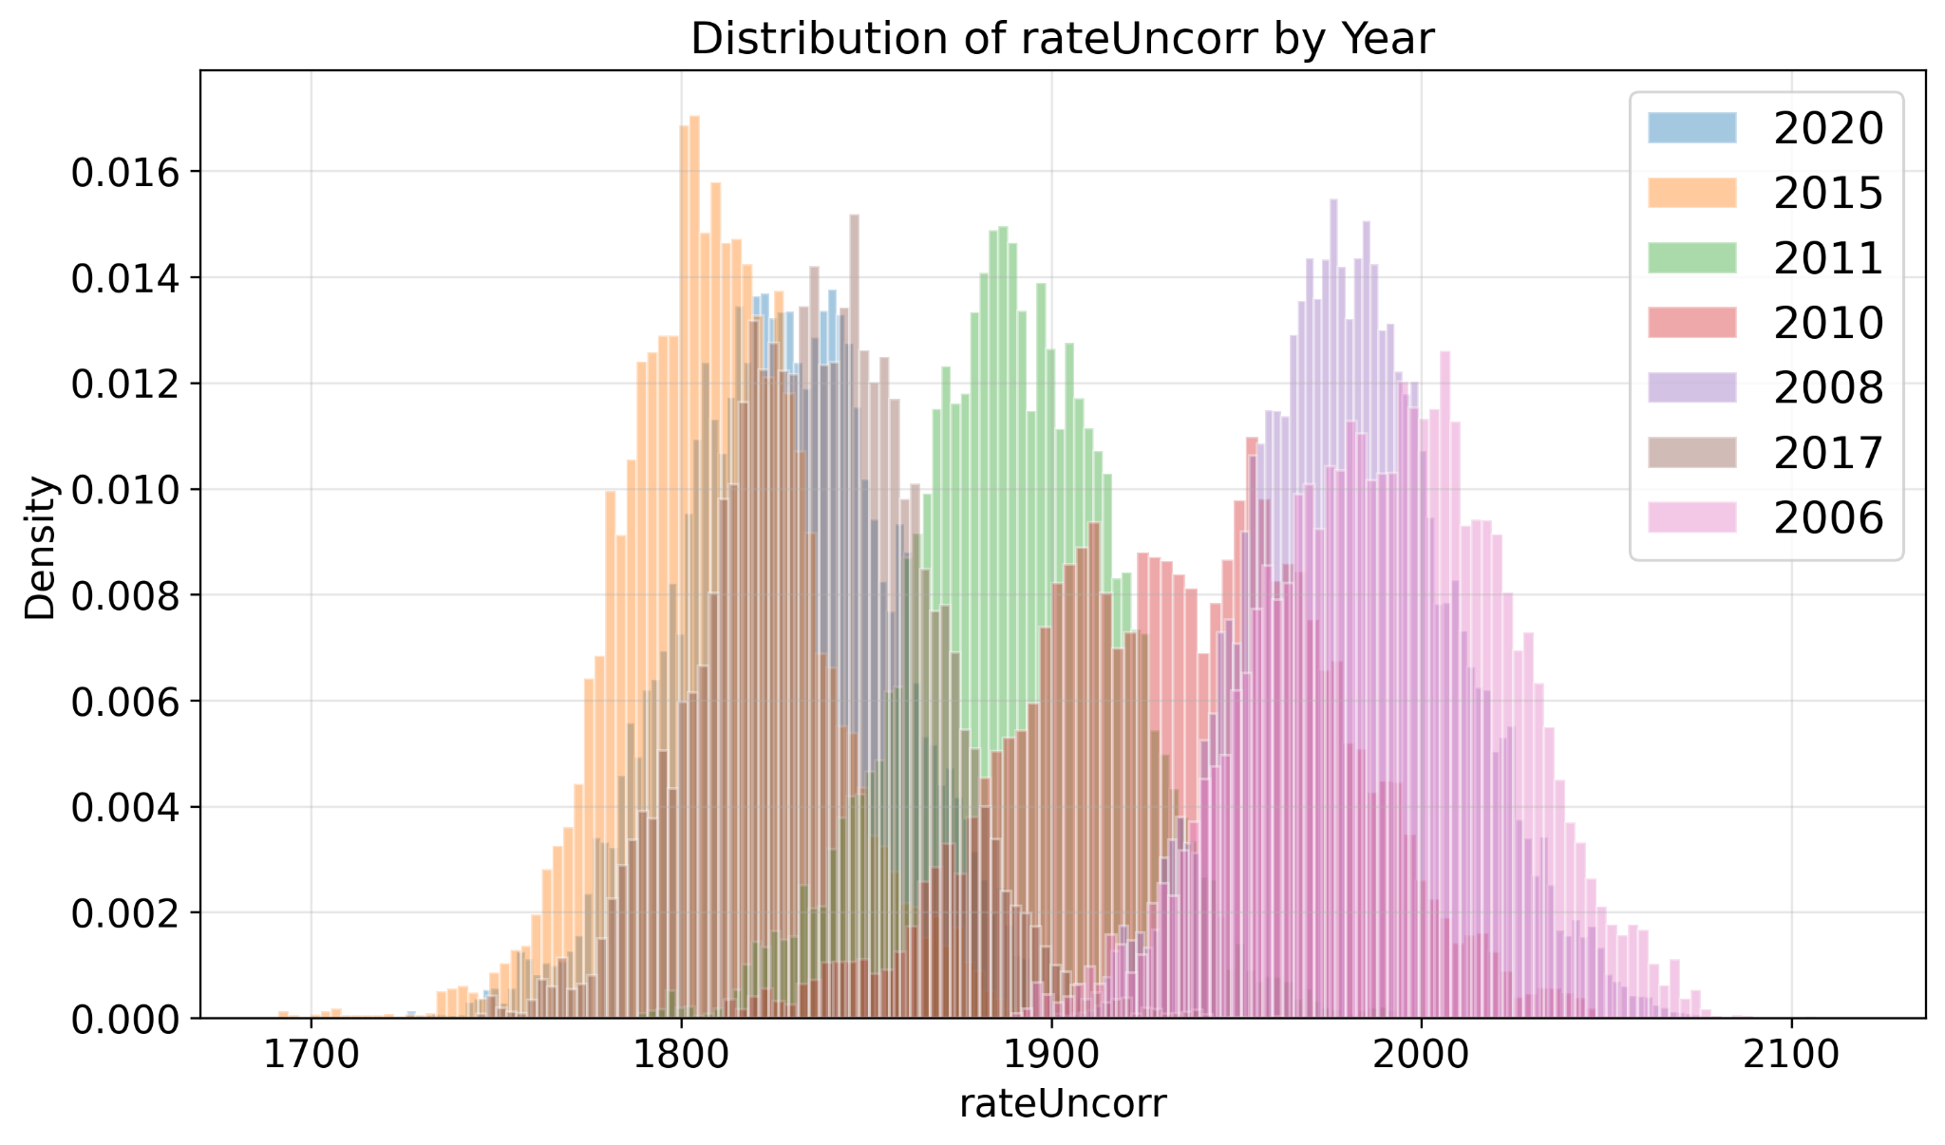
Pre-Processing
Scalar data has average particle count rates over 15 minute intervals
Atmospheric data has average data collected over 5 or 10 minute periods
Inspection of Data revealed high dependency on the year the data was taken
Dependency on year comes from changes in data-taking strategy [9]
Trained on Data taken post 2012
Trained models with year as a one hot encoded feature and without it
Figure 4: Histogram of counts/s by year. Shows high variance between years when data was taken. Each year appears to have its own gaussian distribution

Slide 10
Models
SGDRegressor and HistGradientBoosting
Performed Nested Cross Validation:
5 Fold Outer CV
3 Fold Inner CV
Grid Search for Hyper-parameter optimization
Goal: Minimize Mean Absolute Error
Trained two models, one with OneHotEncoder Year features, one without
Notes:
SGD Regressor is meant to capture the linear relationship, while HistGradientBoost was meant to capture non-linear aspects

Slide 11
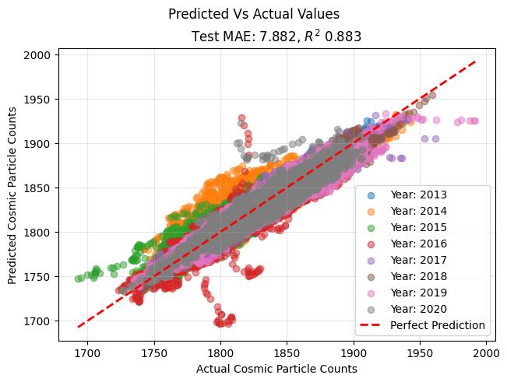
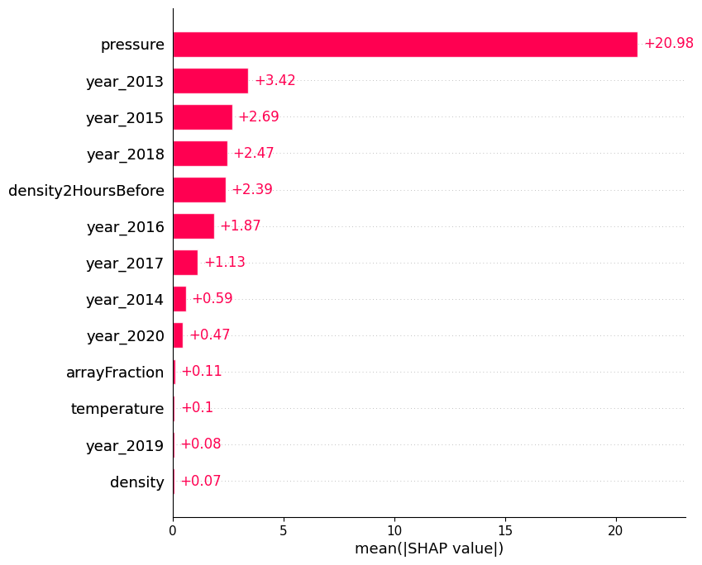
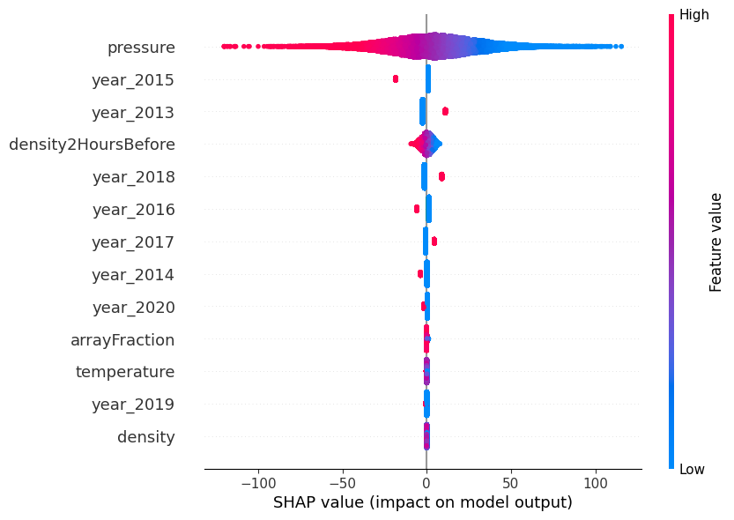
SGDRegressor Performance and Interpretability
Performance with time features: Nested CV MAE = 7.88 +/- 0.01

Slide 12
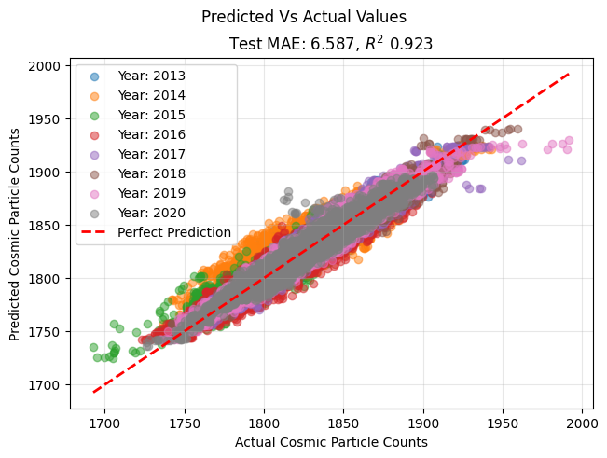
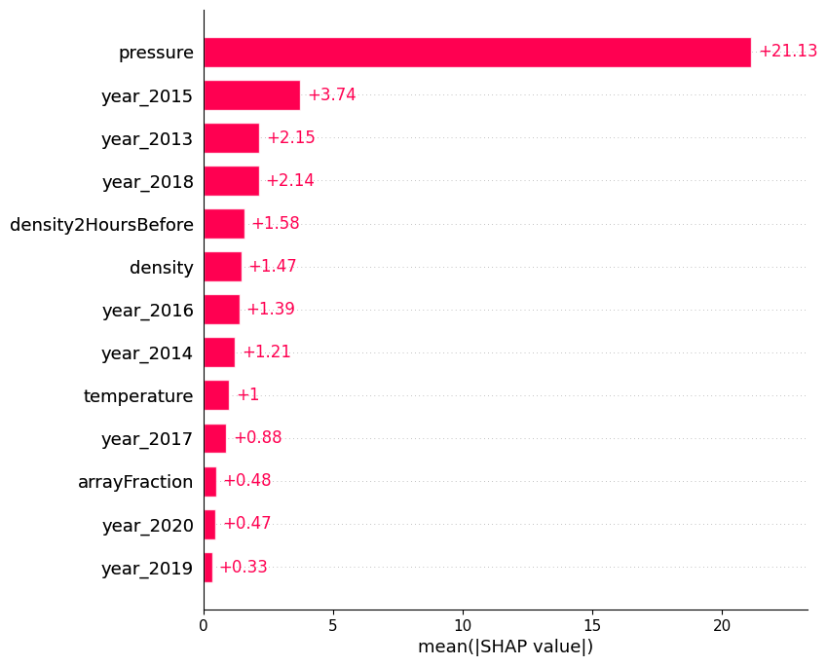
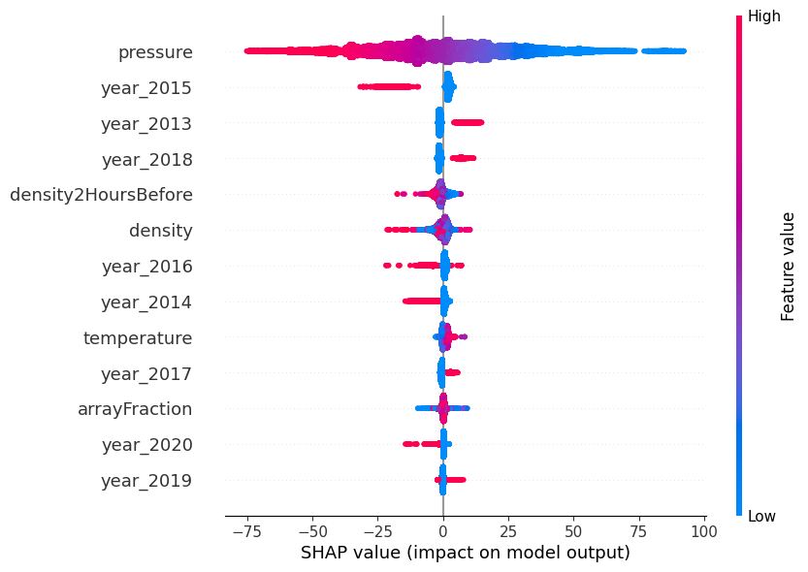
HistGradientBoostingRegressor Performance and Interpretability
Performance without time features: Nested CV MAE = 6.59 +/- 0.02

Slide 13
Conclusions
Results:
HistGradient Boost outperformed SGDRegressor, much faster run time and lower MAE
Both models met out goal of MAE < 15 counts per second with and without year data
Feature Importance confirmed pressure was the major player in decision making
Revealed year as an unexpected important player, revealed inconsistencies in data-taking that the model would have been unable to account for otherwise
Future:
Investigate Weather dependence on particle phenomenology (types of particles, energies, spatial distribution)
Generalize model to work for different locations

Slide 14
References
[1]astronomers-highest-energy-particles(Picture on Presentation Outline Slide)
[2] what-are-cosmic-rays (Picture on Cosmic Ray Slide)
[3]hybrid-detector (Picture of Water Tank on Pierre Auger Slide)
[4]1ef8bb507e47d8bc4ac3b456b7ff55ef(Weather Correction Pierre Auger)
[5]8a20a8621978632d76c43dfd28b67767-Paper.pdf[SHAP Citation]
[6]shap (Shap Image and Github)
[7]10488964[Open-Data]
[8] pdf (Pierre Solar Activity Paper)
[9]pdf(Pierre Scalar Data Paper)

Slide 15
Questions?

Slide 16
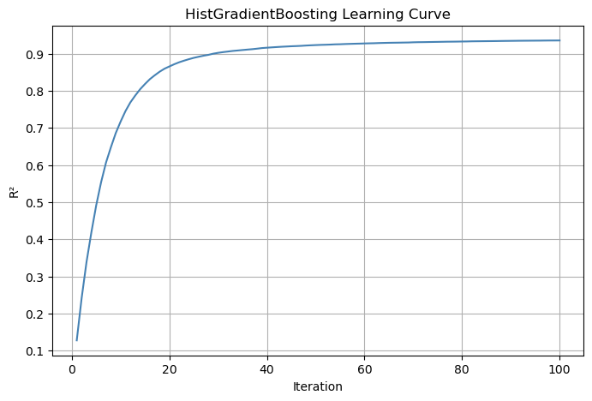

Slide 17
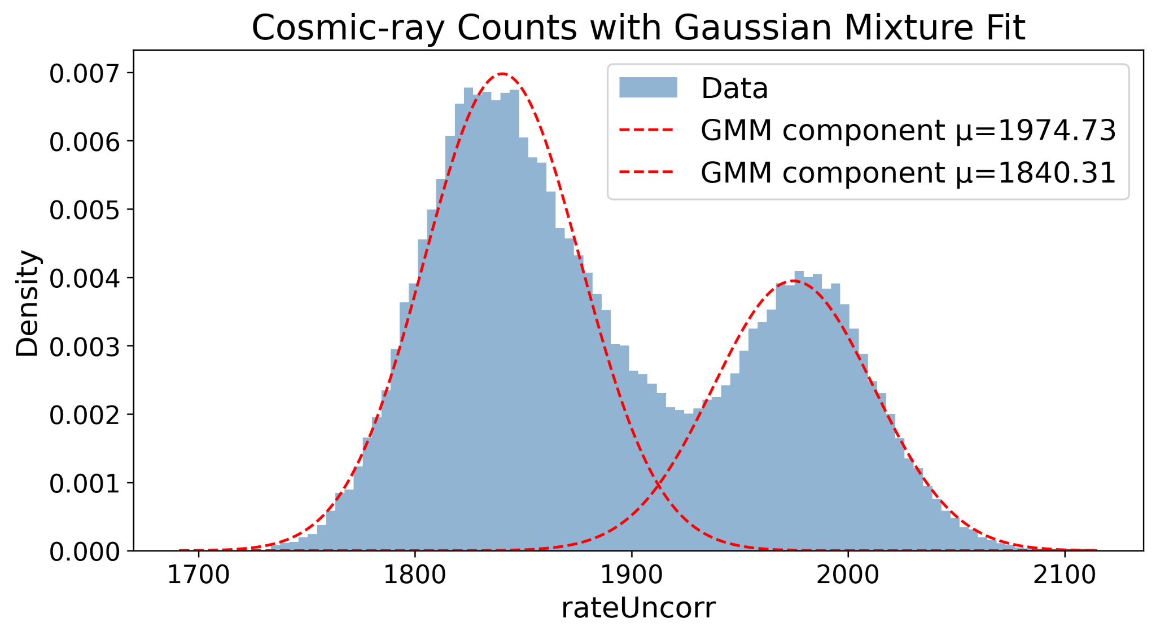

Slide 18
